Slide 1
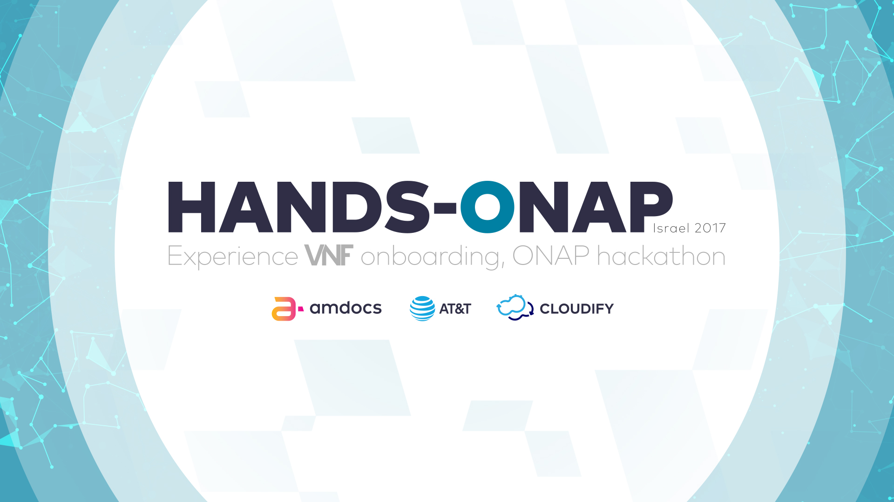

Slide 2

Agenda
Overview
High Level Architecture
Design time Architecture
Run time Architecture
Summary

Slide 3
Outline
Overview
High Level Architecture
Design Component Architecture
Run-Time Component Architecture
Summary

Slide 4
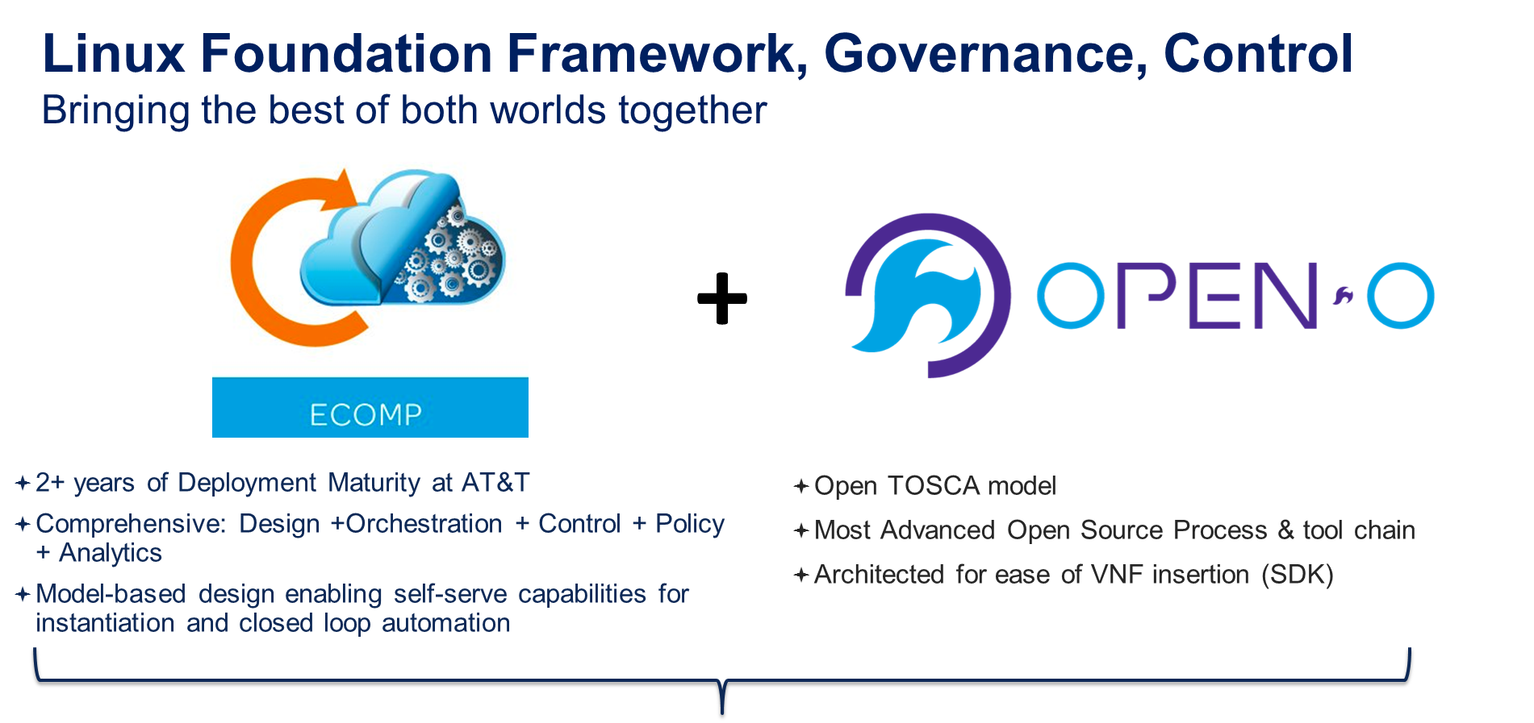

Slide 5
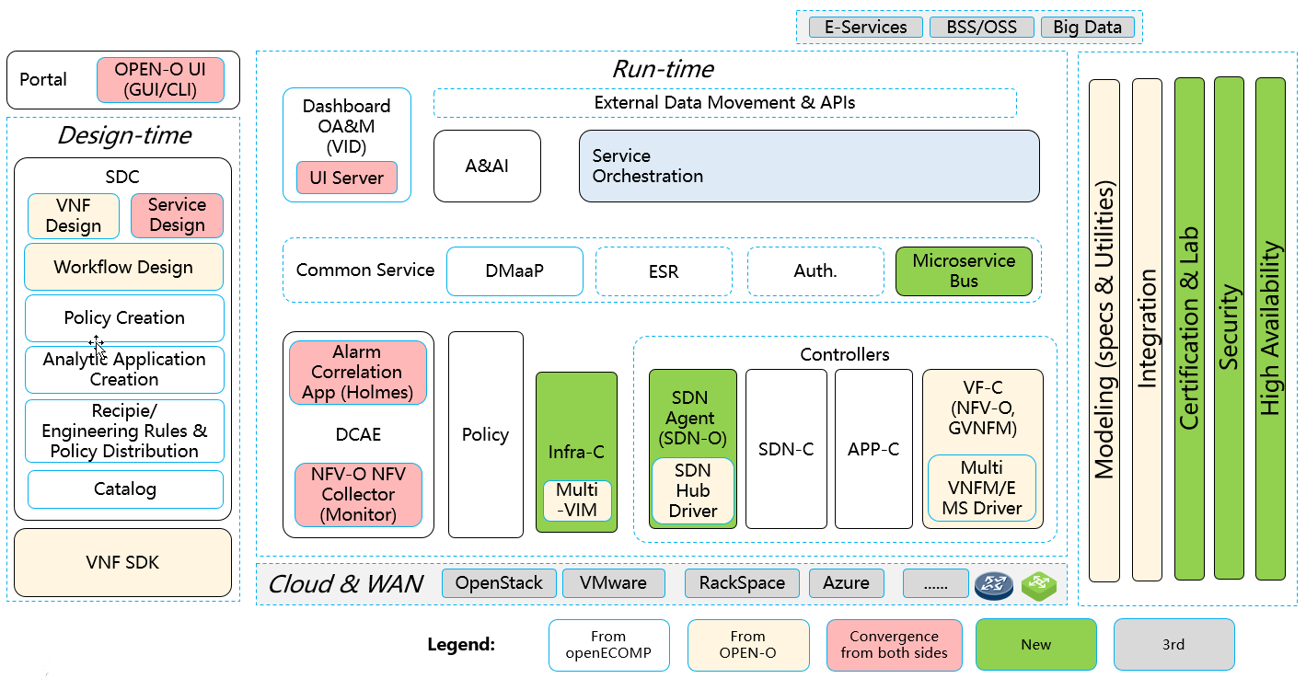
Open ECOMP and Open-O Merger into ONAP harmonized architecture

Slide 6
Overview
High Level Architecture
Design Component Architecture
Run-Time Component Architecture
Summary

Slide 7
ONAP Architecture Overview
Northbound
E-Services BSS/OSS Big Data
Three Main Groups
Design
Deploy
Operate
DESIGN
RUN-TIME
Service Design and Create
Service Orchestrator
Active and Available Inventory
Policy Design
Network Controller
Application Controller
Policy Engine
Closed Loop Design
Data Collection, Analytics and Events
Southbound
Cloud Infrastructure
3rd Party Controller
VNFM/EMS

Slide 8

Overview
High Level Architecture
Design Main Component Architecture
Run-Time Main Component Architecture
Summary

Slide 9

ONAP Service Development life cycle
VNF
VNF
VNF
VNF
Endpoint
Endpoint
Endpoint
1
Onboarding
Design
VNF
Endpoint
2
VNF
Workflow
Workflow
Policies
Policies
VNF
VNF
VNF
VNF
Debug and re-design
\
Operations
Distribution
Packaging
Testing
6
5
4
3
ISSUE
VNF
VNF
VNF
VNF
Self Service Portal
Debug and re-design
EP
EP
EP
VNF
EP
Service Orchestrator
READY
VNF
ISSUE
Active & Available Inventory
Policies /
Workflow
Policies /
Workflow
Notes:
New tooling to fast design and onboard new services & resources
Accelerate, simplify & reduce cost to onboard new service designs & resources
1 –The onboarding of VNF Descriptors (models) and associated artifacts (SW images, Documentation, Templates).
Our onboarding automates the process and provide a scheme for capturing operational requirements and knowledge from experts via interactive wizards including OS support, VNF component makeup and dependencies, VM CPU size and other general or hypervisor specific platform requirements, network, security, non-functional requirements.
Importing of externally provided information (e.g. VNF images or details contained in standard based files formats). Formats like Yang or TOSCA while the standards bodies still mature are generally vendor specific at this time, the import capability can be customized to support these by the addition of an adaptor that provides any bespoke translation.
This stage automatically generate an initial resource definition for next stage( design of service)
Will reduce integration effort per VNF
2- Visual Design of Service - a graphical environment to define services based on these VNFs including policies, thresholds, deployment process models and factors to be used in their operation.
Within the same graphical environment user can combine VNFs into more complex virtual services together with classical resources associated with the physical network.
Palettes of re-usable elements, graphical canvas for drag ‘n’ drop assembly of a network service definitions.
Customizable support for different scenarios:
Service level design templates: vCPE, vEPC, vIMS etc.
VNF design templates: multi-VM, multi-component, load-balanced etc.
Great simplification and validation of design.
3- Testing – ( maybe debugging is better name) lets you take a definition and use the NFVO component to step through the planning function and see the outcomes of any policies that have been configured.
It allows you to view and interact with fixed or derived parameters at each step to make adjustments to any issues in the definition logic, these changes can then be reconciled in the original definition after you have finished debugging.
Debugging applies equally at a Service or VNF level within the definition so that individual parts of a service can be debugged in isolation of the others if required.
4- Packaging - Publishing of the predefined and tested services to a catalogue such that they can be offered to the fulfilment process. Significant benefit of using our NCSO is that service design was tested via target system (NCSO) right on design stage.
5 - Distribution of essential artifacts and information such as software images, policy definitions, model definitions, performance thresholds, etc. to key consuming systems –NFV Orchestrators, catalogues, VIM, assurance etc.
This process today mainly manual – we targeting to automate distribution – i.e. significantly reduce time and cost of handover from design stage to service build/ fulfillment stage.
VNF Managers, SDN Controllers and the VIM itself have their own metadata requirements. This metadata is partial derived but linked to the service and resource definitions used by the orchestrator. The SDC component can build artefacts or other metadata from the service and resource definition model and any associated extensions, store and version these within its registry.

Slide 10
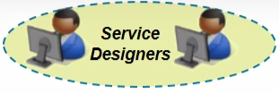





ONAP SDC Architecture Overview
3rd Party Vendor
Tester
Developers
Portal
Project Management
DevOps
GUI
SDC
VNF SDK
Design Managed Objects
Design Managed Functions
Resource Onboard & Design
Service Design
VNF
(Product) Design
Policy
(Rules) Design
Process (BPMN) Design
Analytics (Event-Driven)
Design
Certification
Studio
(ICE)
Distribution
Studio
Content Mgmt & Distribution
Testing & Certification
Design Studio
Reference Data
Catalog
Repositories
Resource Model
Product Model
Product Model
Product Model
Product Model
Product Model
Service Model

Slide 11
Overview
High Level Architecture
Design Main Component Architecture
Run-Time Main Component Architecture
Main Process and Flows

Slide 12
ONAP MSO (SO) Architecture and Interfaces Overview
OCX/OMX
Infrastructure Portal
SDC
CSI
REST
REST
MSO
Interfaces
SDC
Distribution of orchestration artifacts
UEB event notifications, HTTP artifact retrieval
AAI
Query and update inventory
RESTful API
Multi-VIM
Instantiation of virtual resources in the cloud
Openstack APIs (primarily Heat and Keystone)
SDN Controller
Assign and configure network resources
Yang-based RPC and REST
App Controller
Assign and configure application resources
Yang and/or event based API
API Handler
Request Handlers
REST
Service Recipes
BPEL Execution Engine
Data Stores
Service Recipe
Catalog DB
Request DB
AAI
Service Recipe
REST
HEAT Templates
SOAP
Resource/Controller
Adapters
VNF Resource Adapter
Network Adapter
Controller Adapter
KEYSTONE/ HEAT
REST
Cloud Platform Orchestrator
SDN Controller
APP Controller

Slide 13
ONAP SDN-C Architecture and Interfaces Overview
DG
Builder
Directed
Graph
Files – XML
(Eng Rules)
Network Data
Model
Files – YANG
(i.e. IPAG EMT)
Service Data
Model
Files - YANG
(i.e.UNI port)
DMaaP
Message Router
Security
Applications
Control Loop
Applications
Service
Orchestrators
API (REST)
API (REST)
API (REST)
Service-related Artifacts for SLI, API Handlers, Network Adpaters
API Handlers
API (REST)
SDN-C
External API calls
Service Logic Interpreter
A&AI
OpenDaylight
SDN-C Database
REST
Inventory
Service Logic/Eng Rules
Assigned Resource Inventory
Config
Tree
Operational Tree
Network Adapters
OpenStack
Adapter
VOIP VNF
Adapter
VRR Smart Adapter
Support CLI/NetConf/BGP
vCE/vPE
Smart Adapter
BGPCEP
Adapter
Etc.

Slide 14
ONAP APP-C Architecture Overview
Infrastructure Portal
Designer
App-C
Configuration Management
Control Loop Actions
Restart
Rebuild
Migrate
Suspend / Destroy
MSO
Other Components
APP-C
UEB
DG Compiler
API
Service & Config Repository
Service Abstraction Layer
YANG/SLI Model Driven Services
DCAE
Adapters
A&AI
A&AI Adapter
PO Adapter
NETCONF Adapter
VNF / APP
Adapter …
UEB Adapter
AIC PO
VNF
VNF
App1
App2

Slide 15
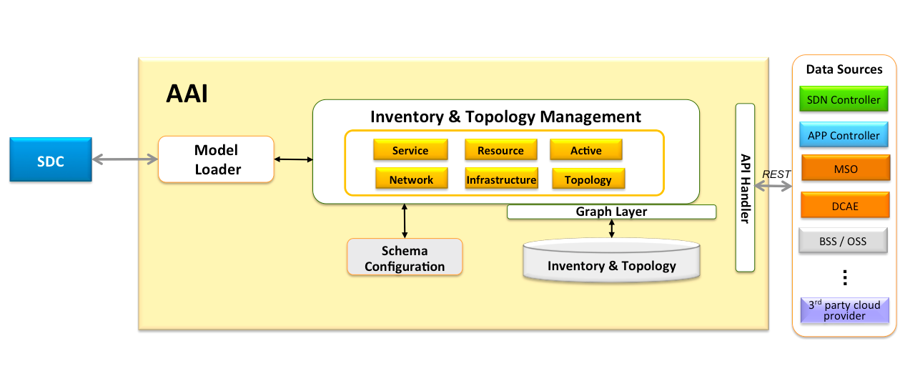
ONAP A&AI Architecture Overview
Central registry to create a global view of inventory and network topology
Receives updates from various inventory
Provides standard APIs

Slide 16
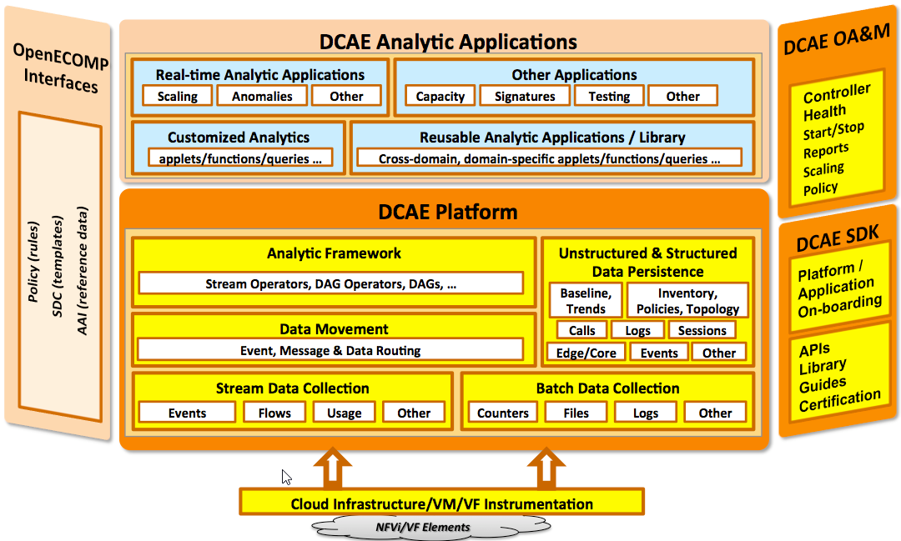
ONAP DCAE Architecture Overview
Data Collection, Analytics, and Events (DCAE) subsystem
gathers performance, usage, and configuration data from the managed environment
This data is then fed to various analytic applications, and if anomalies or significant events are detected
The primary functions of the DCAE subsystem are to
Collect, ingest, transform and store data as necessary for analysis
Provide a framework for development of analytics

Slide 17
Overview
High Level Architecture
Design Main Component Architecture
Run-Time Main Component Architecture
Summary

Slide 18
ONAP Service Lifecycle Management
DESIGN
ORCHESTRATE
OPERATE
PRODUCT CATALOG
DESIGN—ONBOARDING
OFFLINE
IN LAB
CONTINUOUS REAL-TIME FULFILMENT
REAL-TIME
IN PRODUCTION
REAL TIME
OPERATION
HYBRID CLOUD

Slide 19
Design Flow – VNF and Service Design
Enrich model with monitoring, management dependencies etc.
Create VF and Service designs
Manually test models in lab
Deploy to product servers
3
4
5
6
Build topology from vendor info (HEAT or manual)
On board
Design
Test
Deploy
2
Technology Specialist
Model vendor license
Service Designers and Operations
1
Asset Manager
Testers
Operations
Develop
Deliver
Supplier
Quarantine
0
Security and malware scanning
Partners

Slide 20
